Slide 1
School environment

Slide 2

My school
School

Slide 3
Daily schedule

Slide 4
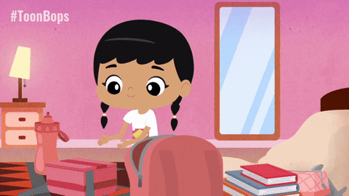
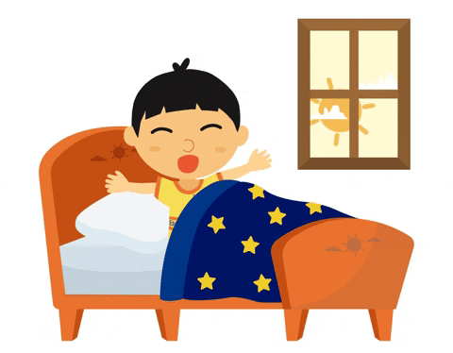
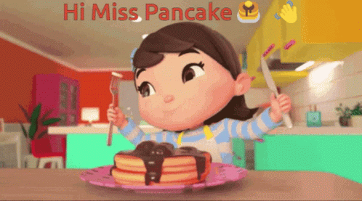
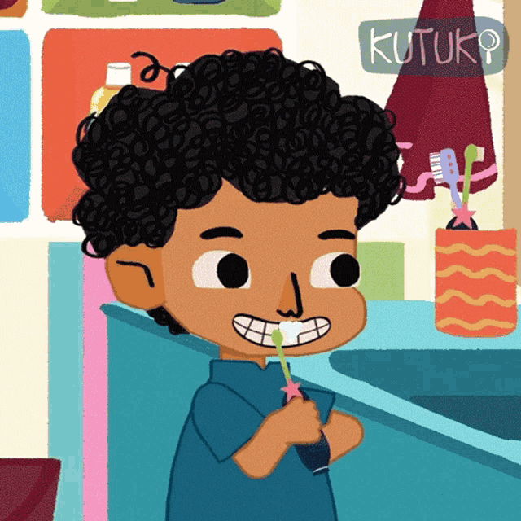
I wake up
I have breakfast
I brush my teeth
I get dressed

Slide 5
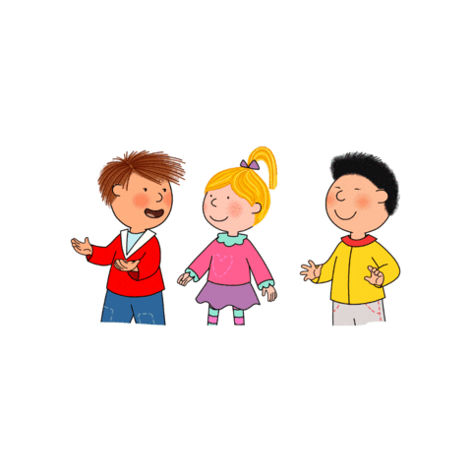

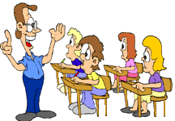
I go to school
I meet children
I attend classes

Slide 6
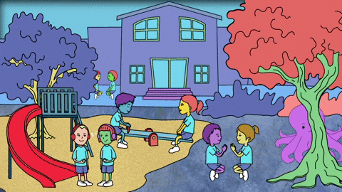
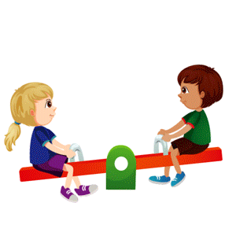
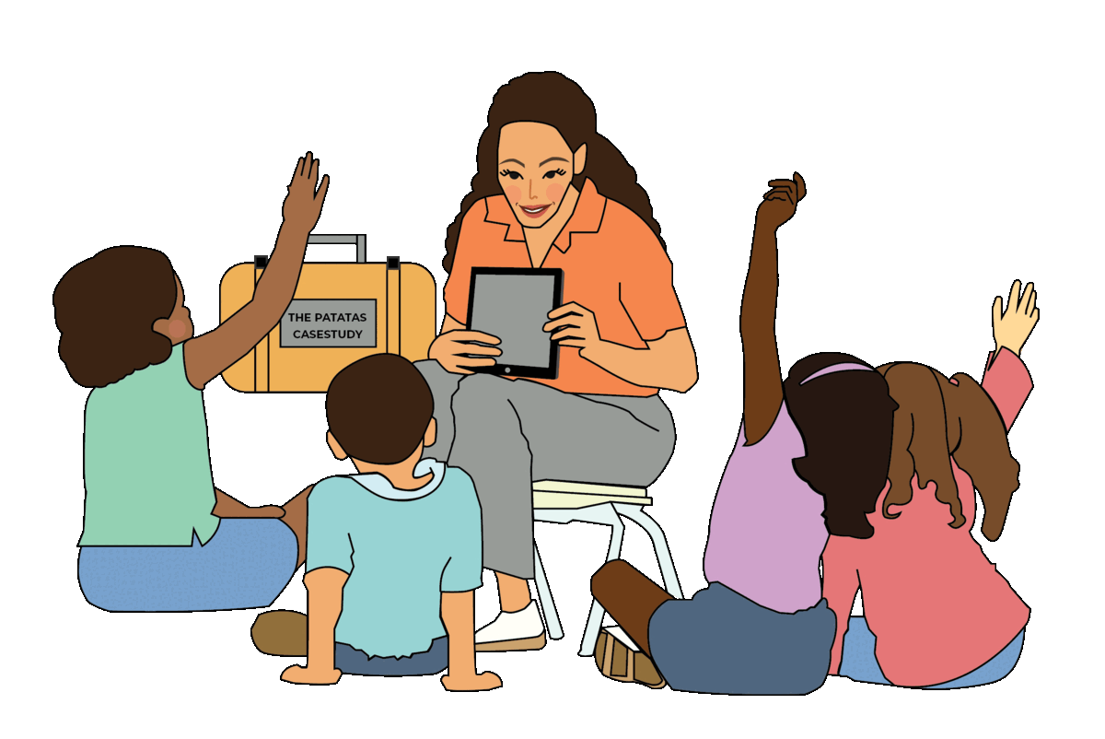
I play in the school yard
I have fun with friends
I listen to my teacher

Slide 7

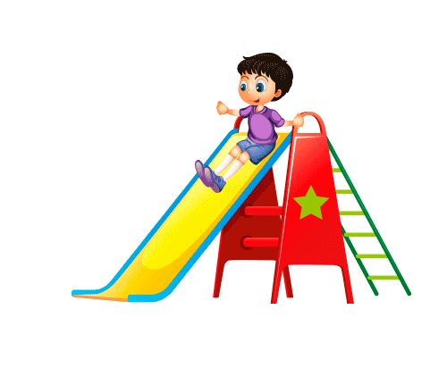
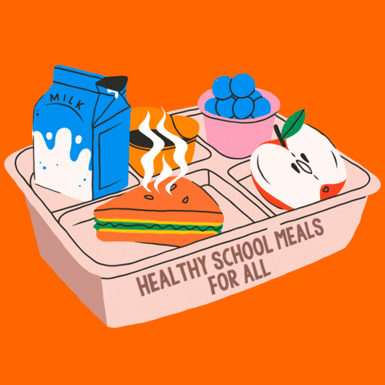

I eat lunch
I go home
I do homework
I go to park

Slide 8
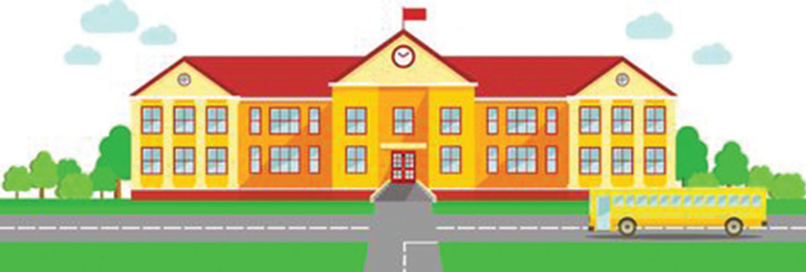
School Environment

Slide 9
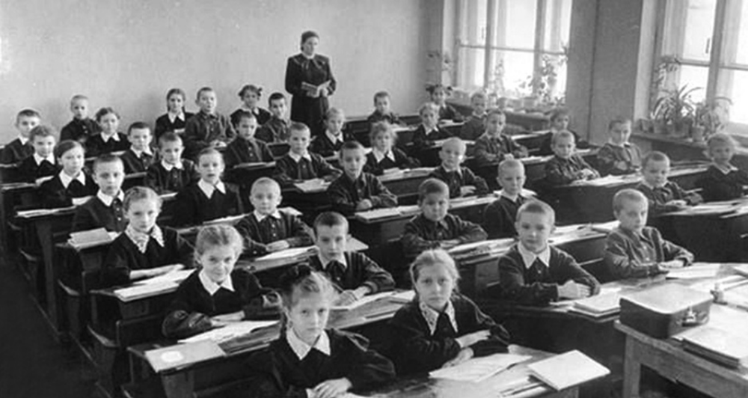
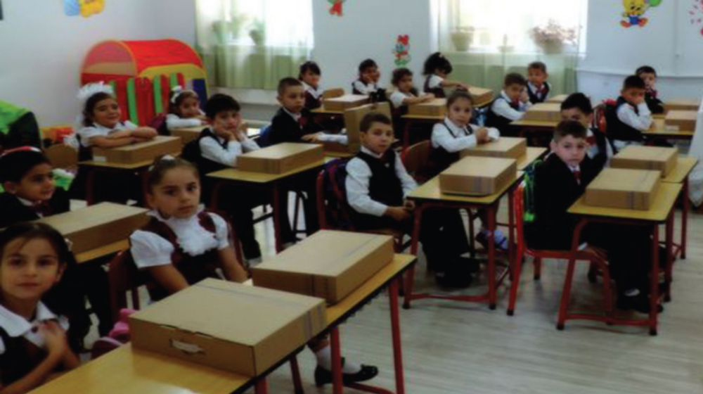
School back in the day School today

Slide 10
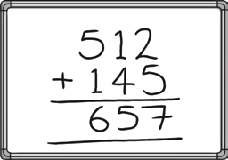


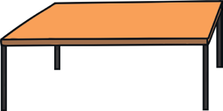
PUBLIC PROPERTY AT SCHOOL
Desk
Whiteboard
Chair
Clock

Slide 11
THESE ITEMS BELONG TO EVERYONE AT SCHOOL

Slide 12
WE SHOULD TAKE A GOOD CARE OF THESE ITEMS

Slide 13
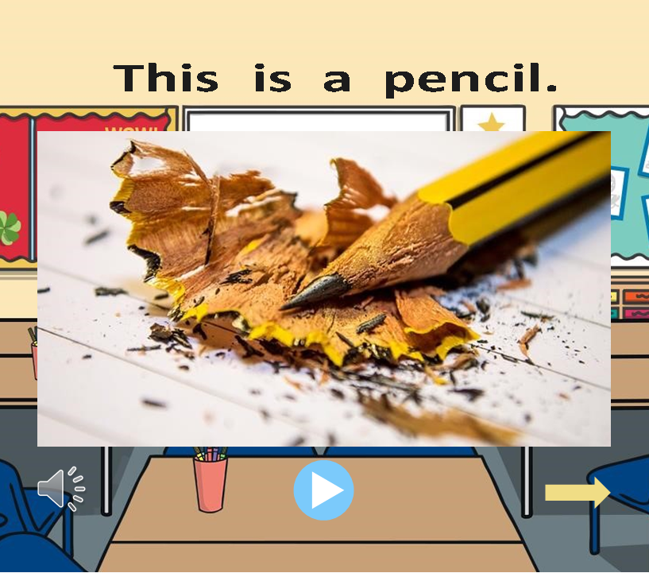

PENCIL

Slide 14
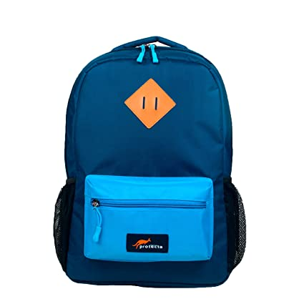
SCHOOL BAG

Slide 15
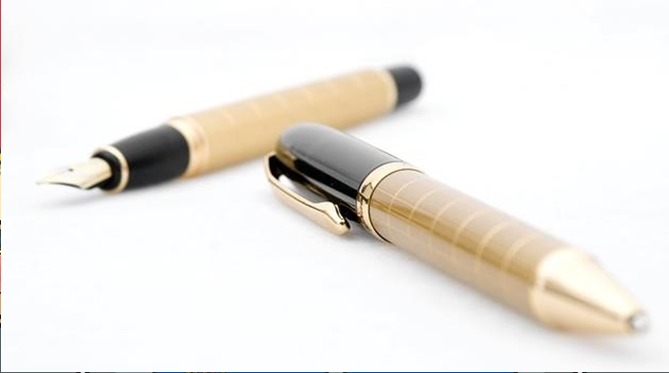
PEN

Slide 16
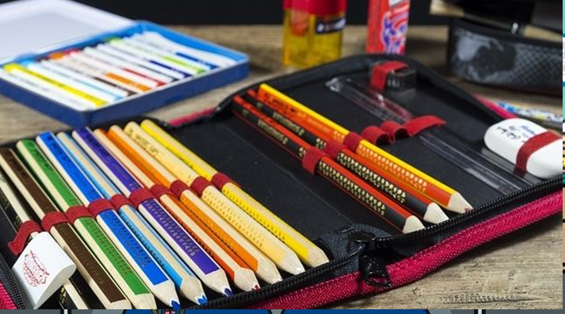
PENCIL CASE

Slide 17
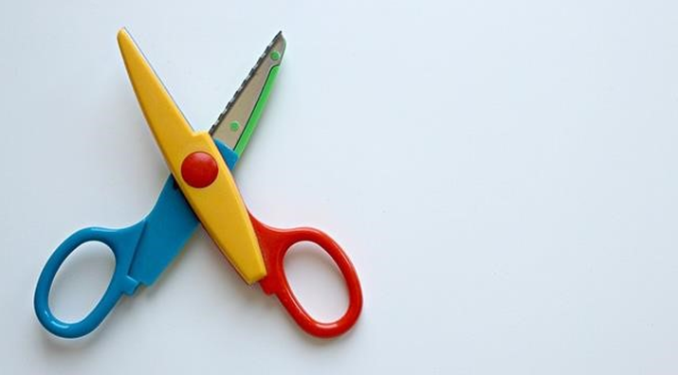
SCISSORS

Slide 18
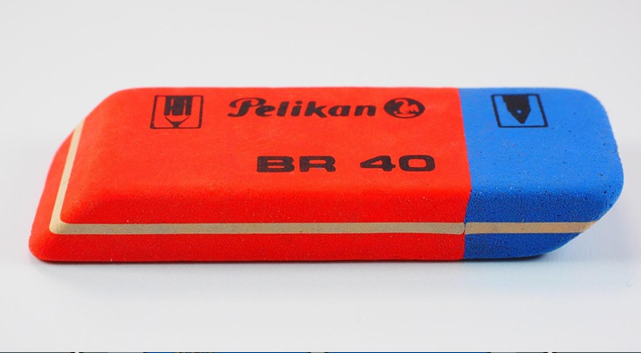
RUBBER

Slide 19

BOOK

Slide 20
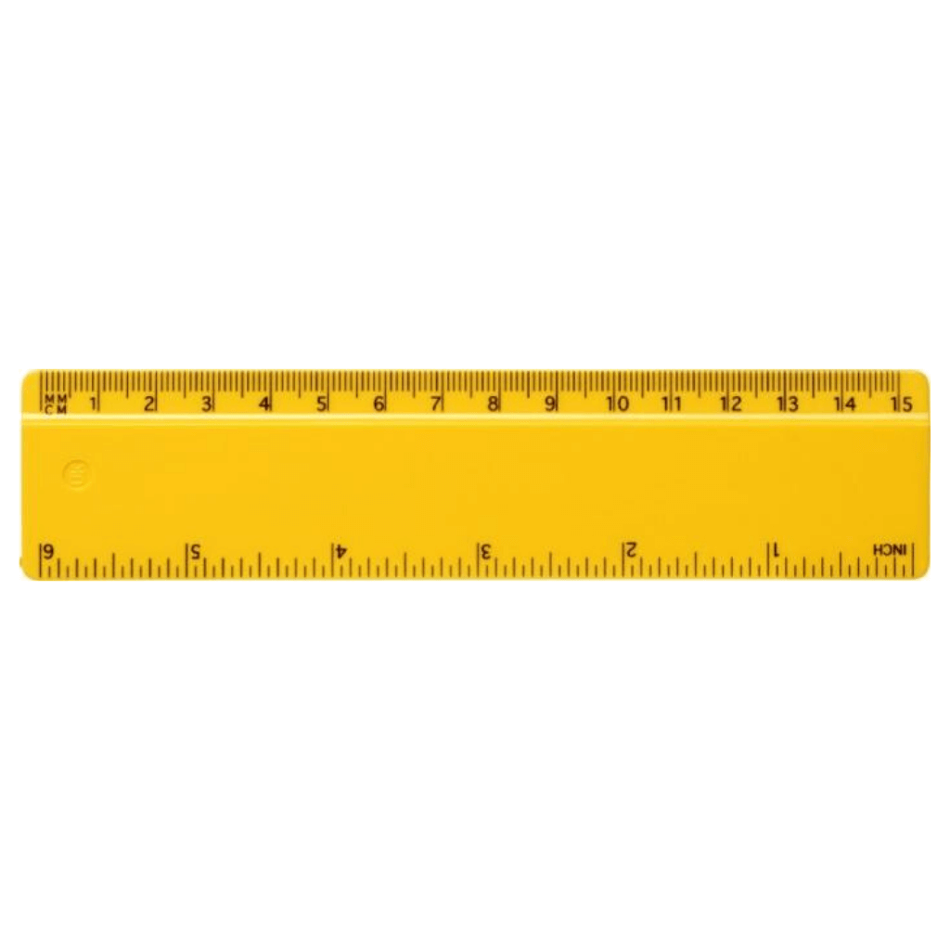
RULER

Slide 21

NOTEBOOK

Slide 22
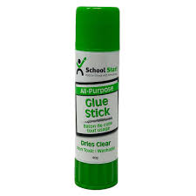
GLUE

Slide 23
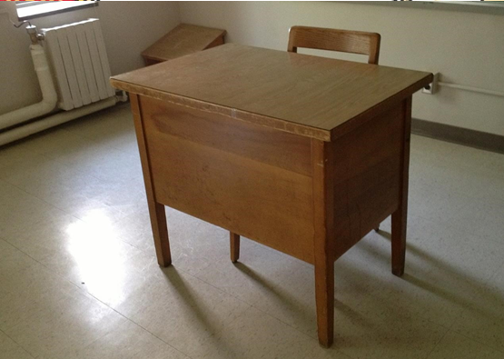
DESK

Slide 24
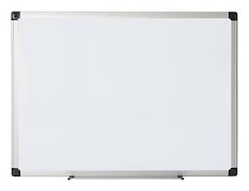
WHITEBOARD

Slide 25
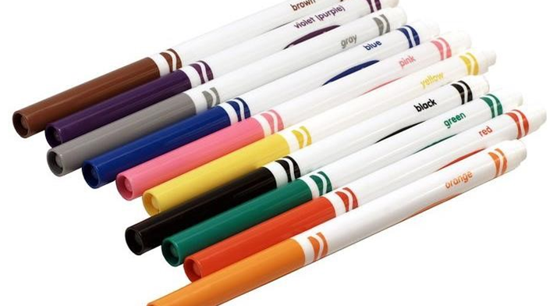
FELT PENS

Slide 26
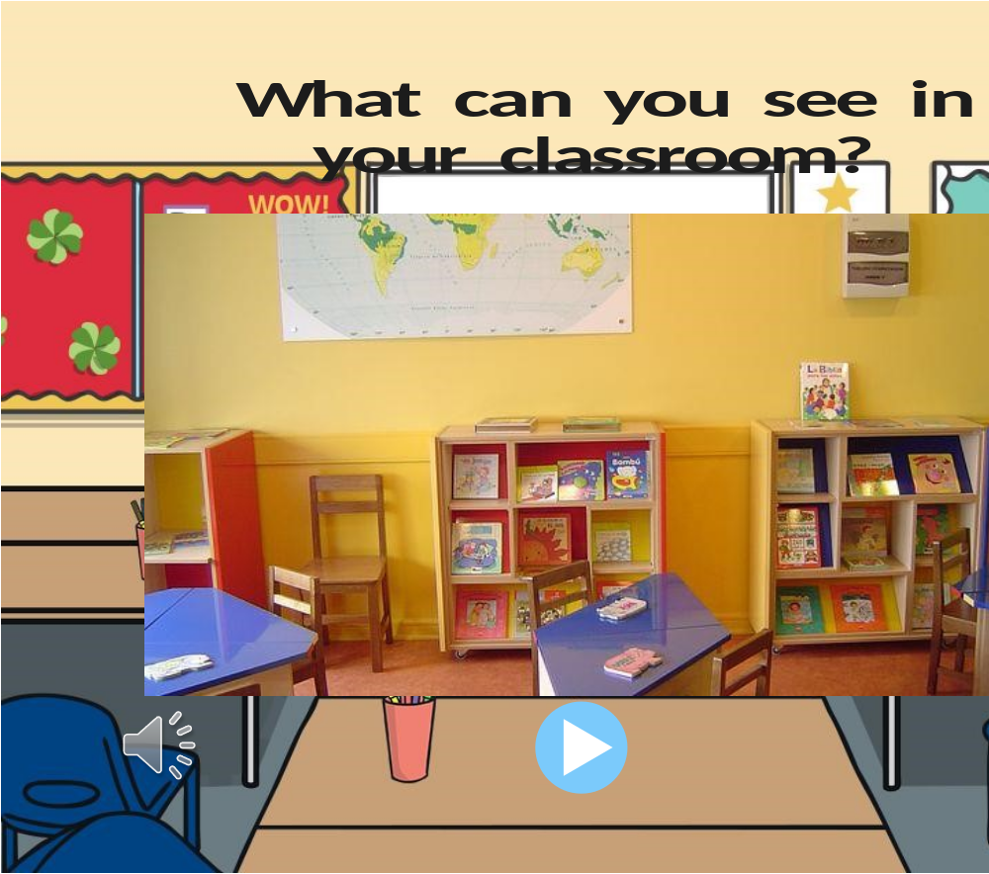
WHAT CAN YOU SEE IN YOUR CLASSROOM?

Slide 27
CLASSROOM RULES

Slide 28

LISTEN TO THE TEACHER

Slide 29

PUT YOUR HAND UP TO SPEAK

Slide 30
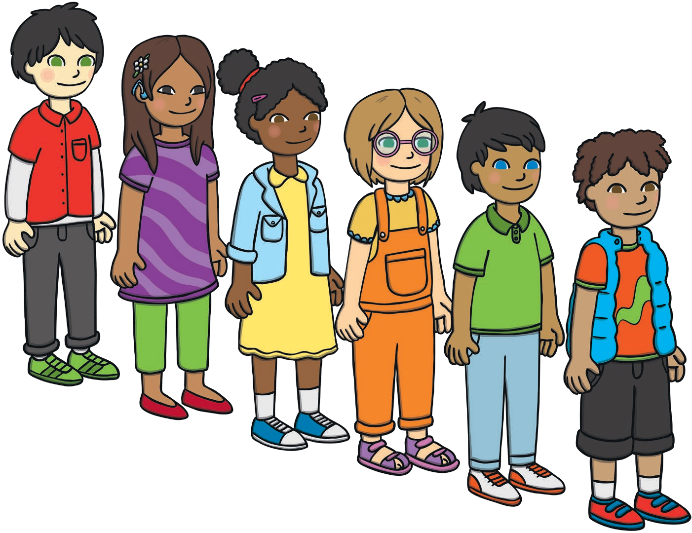
WALK IN THE LINE

Slide 31
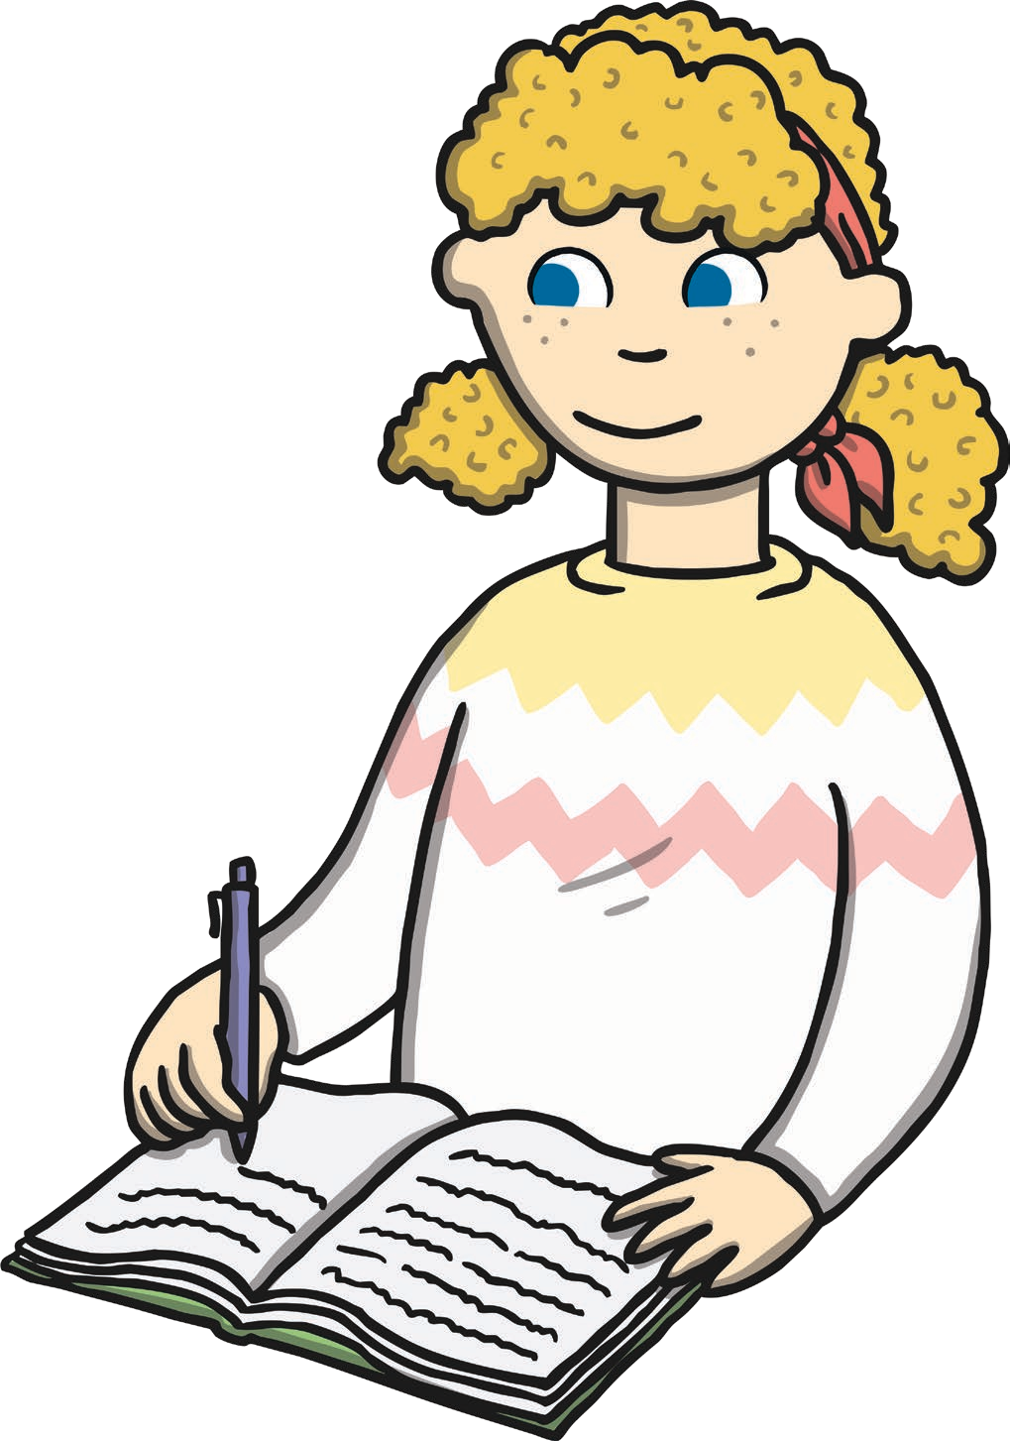
DO YOUR BEST WORK

Slide 32
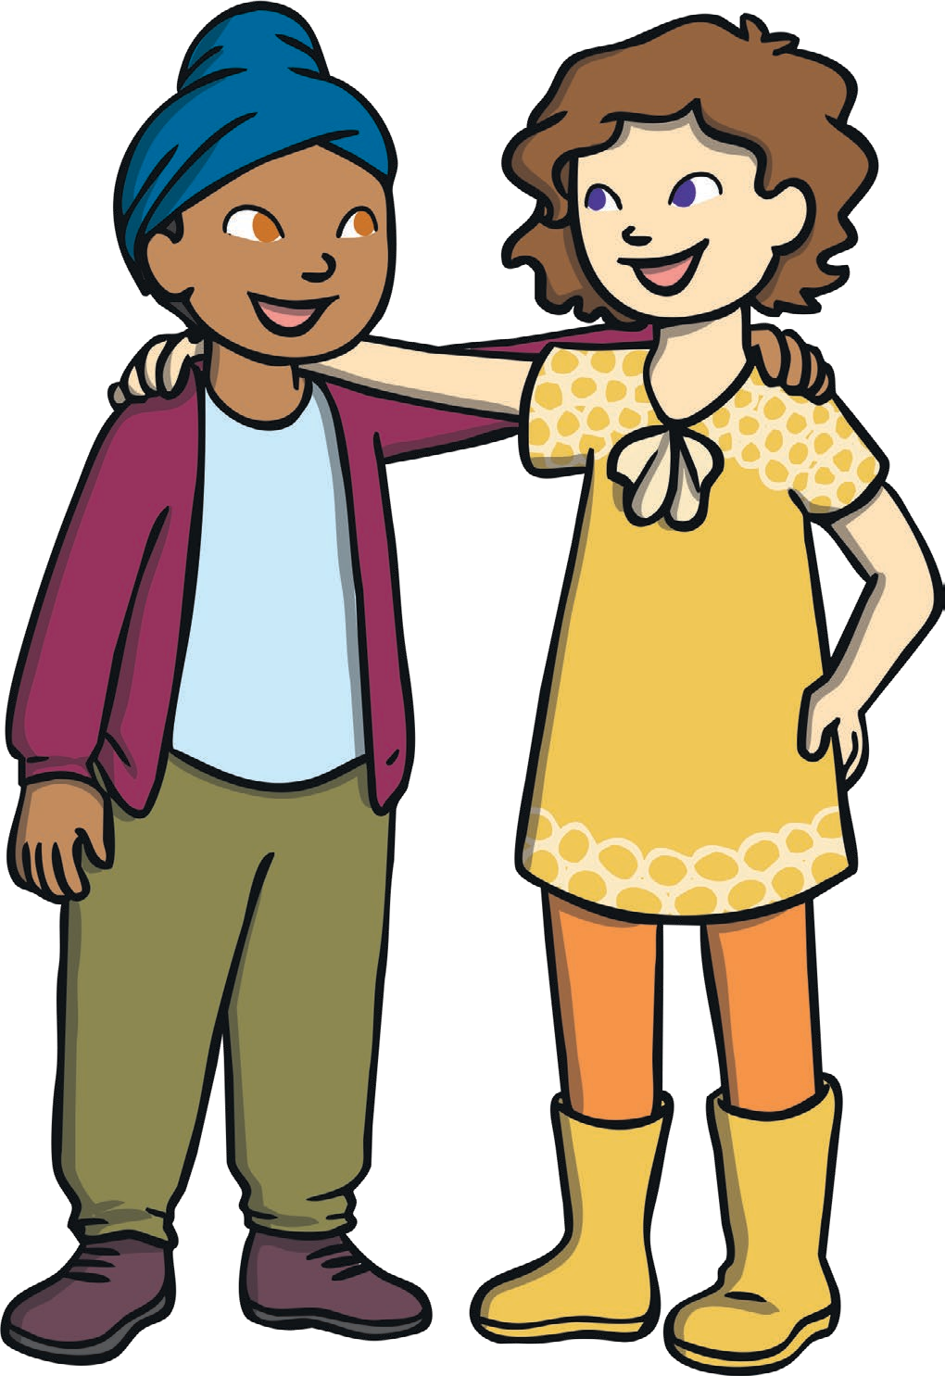
BE KIND TO YOUR FRIENDS

Slide 33
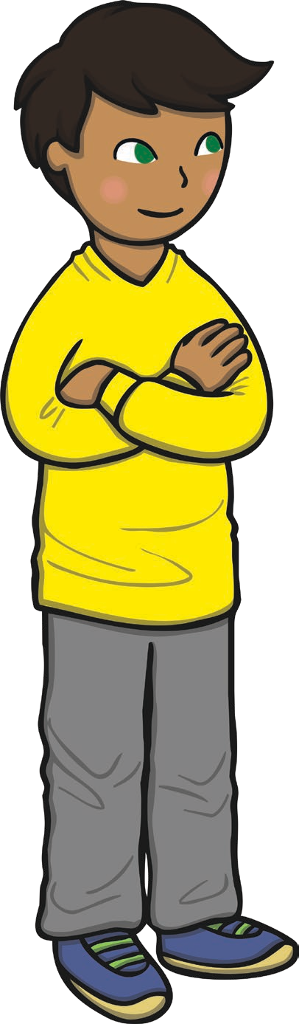
PAY ATTENTION

Slide 34
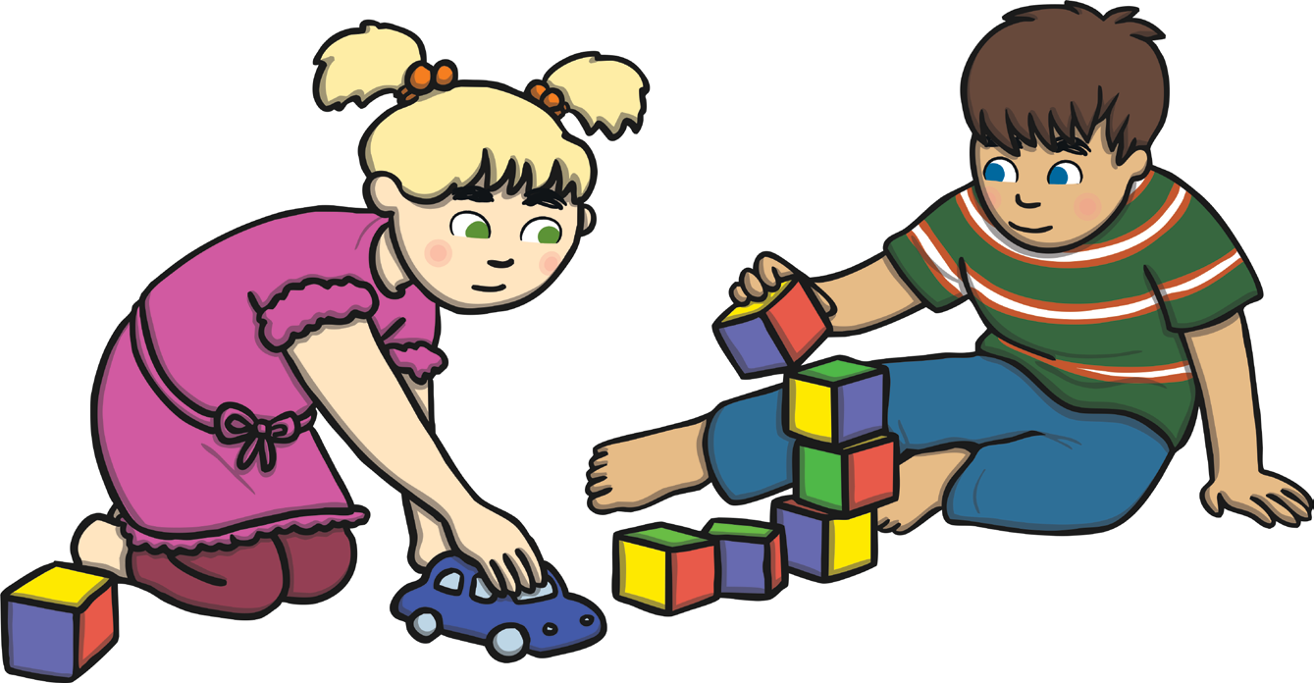
TREAT THINGS WITH RESPECT

Slide 35

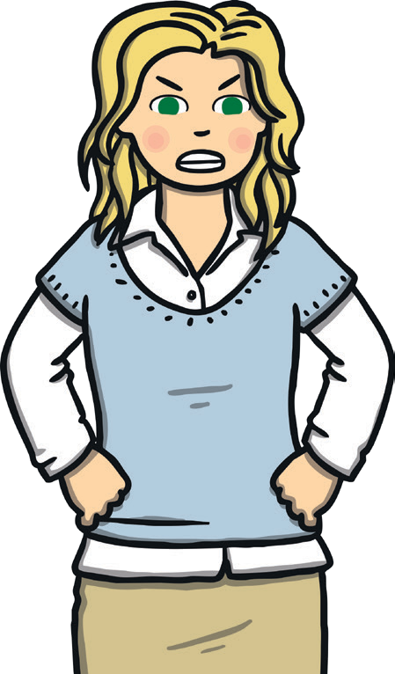
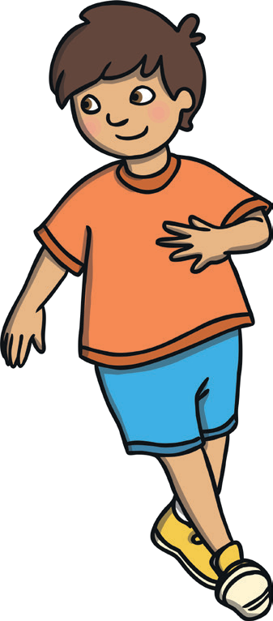
WHICH ONE IS THE CLASSROOM RULE?
LISTEN TO THE TEACHER
DON’T LISTEN TO THE TEACHER

Slide 36
რომელია სკოლაში ქცევის წესი?
LISTEN TO THE TEACHER
DON’T LISTEN TO THE TEACHER

Slide 37
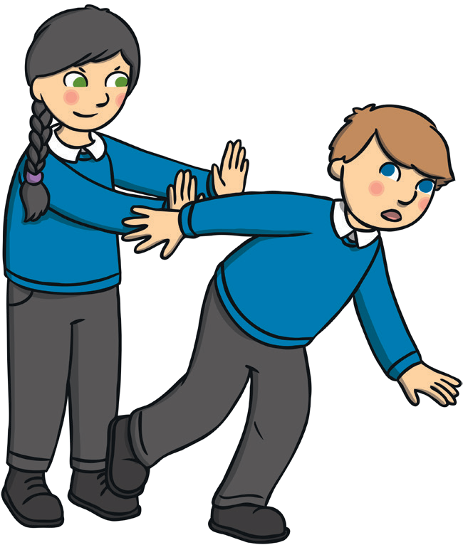
WHICH ONE IS THE CLASSROOM RULE?
PUSH YOUR CLASSMATE
BE KIND TO YOUR FRIENDS

Slide 38
WHICH ONE IS THE CLASSROOM RULE?
PUSH YOUR CLASSMATE
BE KIND TO YOUR FRIENDS

Slide 39
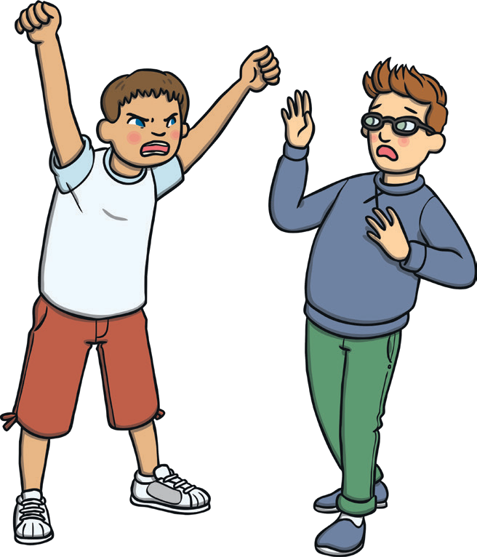
WHICH ONE IS THE CLASSROOM RULE?
DO YOUR BEST WORK
SHOUT OUT LOUD

Slide 40
WHICH ONE IS THE CLASSROOM RULE?
DO YOUR BEST WORK
SHOUT OUT LOUD

Slide 41
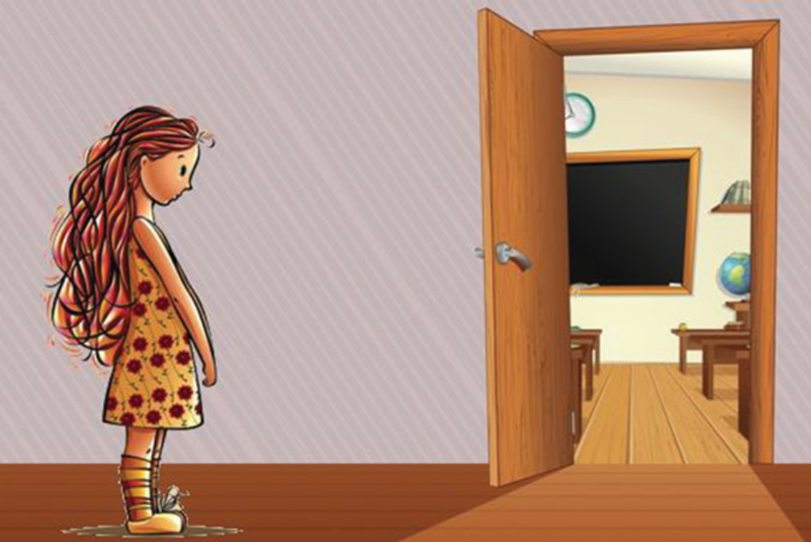
MAKA IS ALWAYS LATE. THE LESSON HAS ALREADY STARTED.

Slide 42
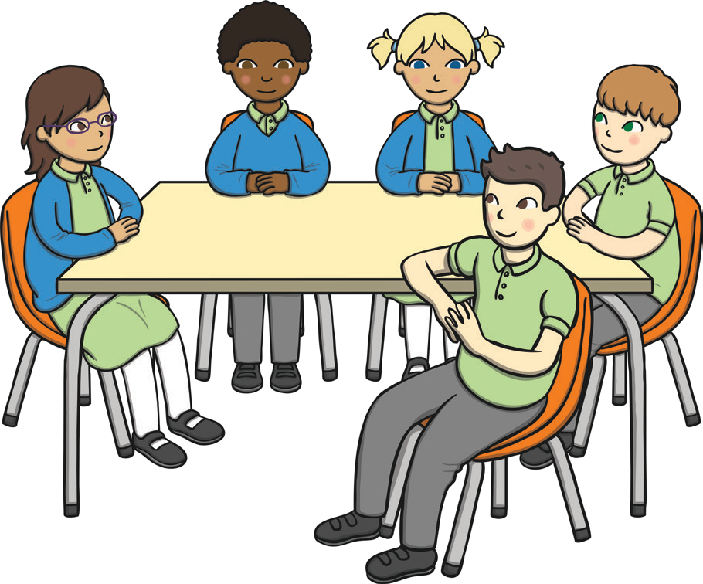
YOU NEED TO BE IN THE CLASSROOM BEFORE LESSON STARTS.

Slide 43
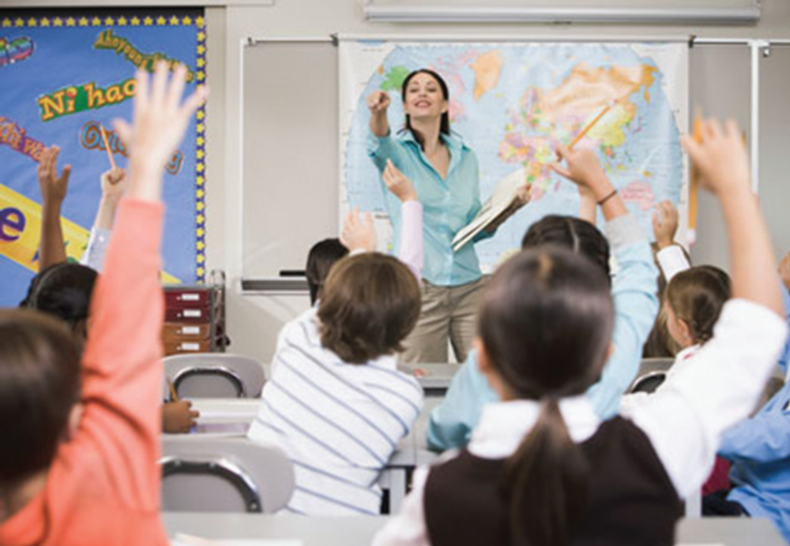
RAISE YOUR HAND, IF YOU KNOW THE ANSWER!

Slide 44

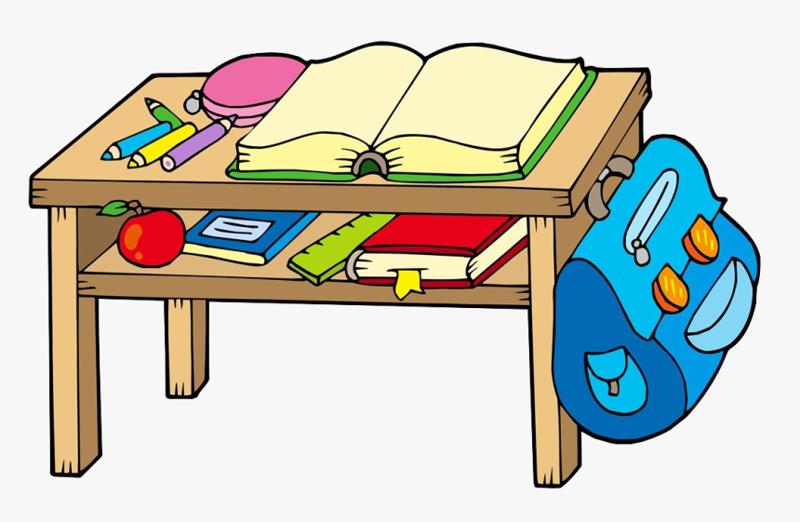
YOU MUST PREPARE A PAPER, BOOKS AND NOTEBOOKS FOR THE LESSON

Slide 45
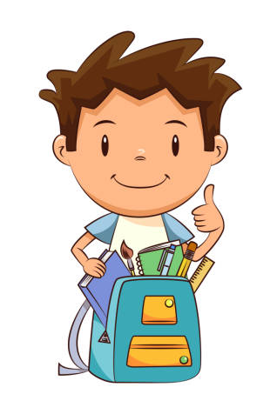
YOU MUST ALWAYS CARRY THE NECESSARY SCHOOL SUPPLIES WITH YOU

Slide 46
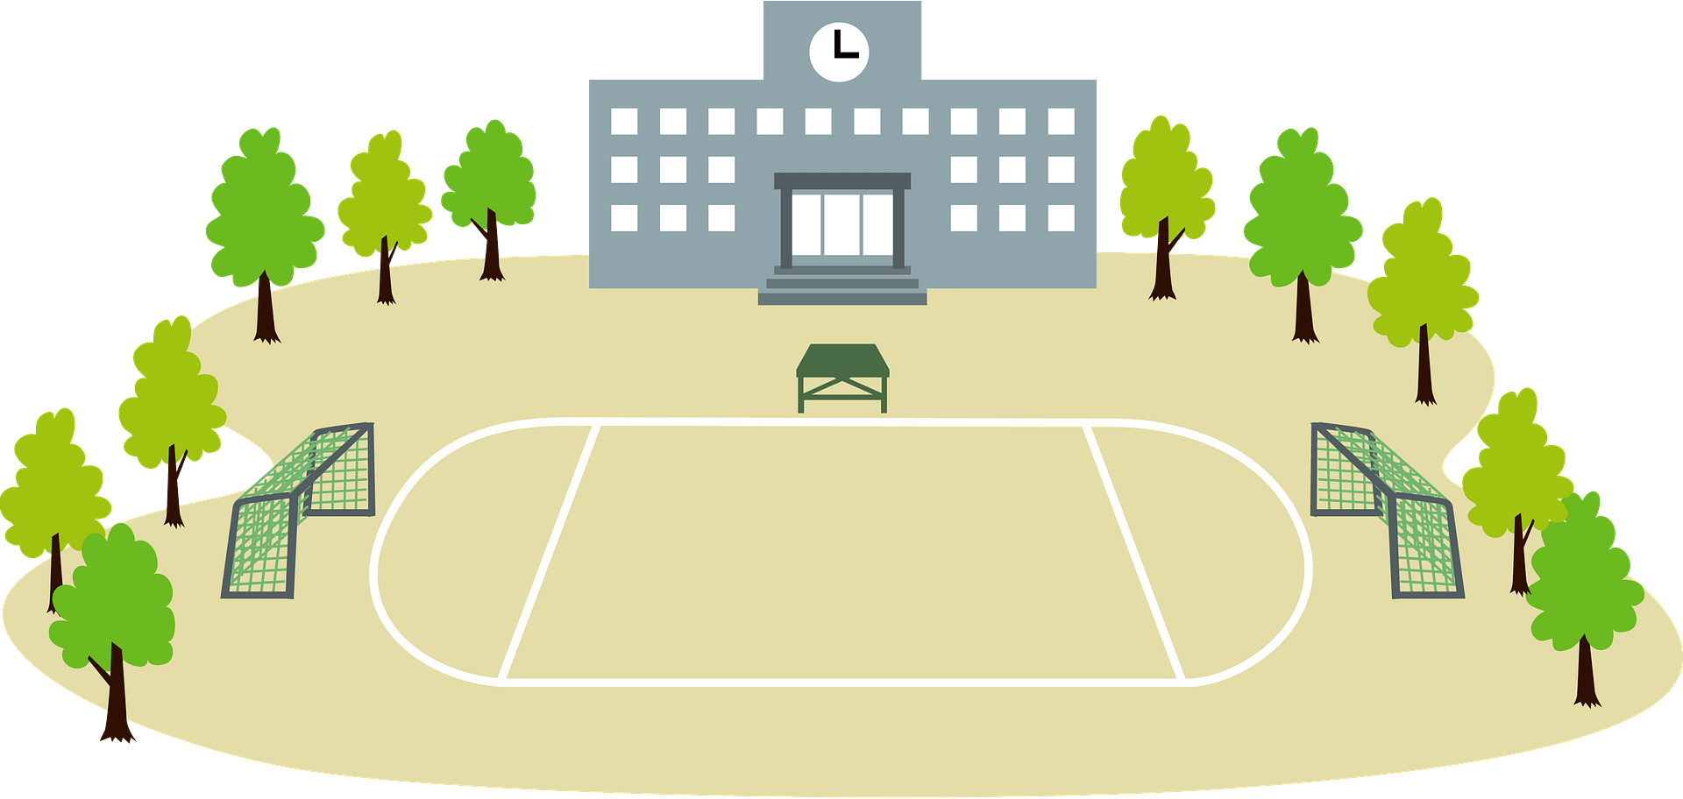
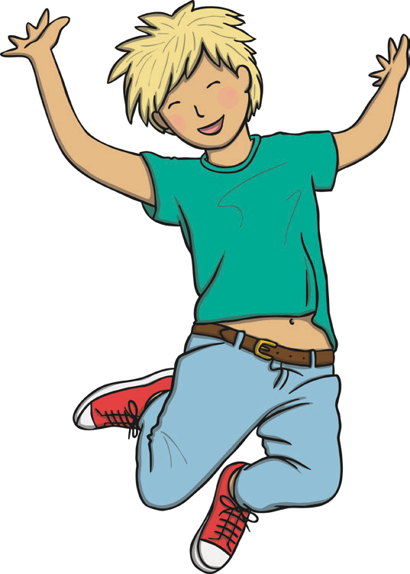

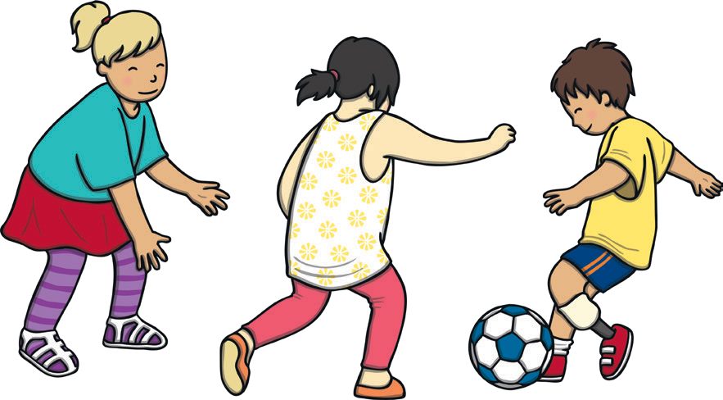
RUNNING, JUMPING AND PLAYING IS BETTER IN THE SCHOOLYARD
JUMPING
RUNNING
PLAYING

Slide 47
Games

Slide 48
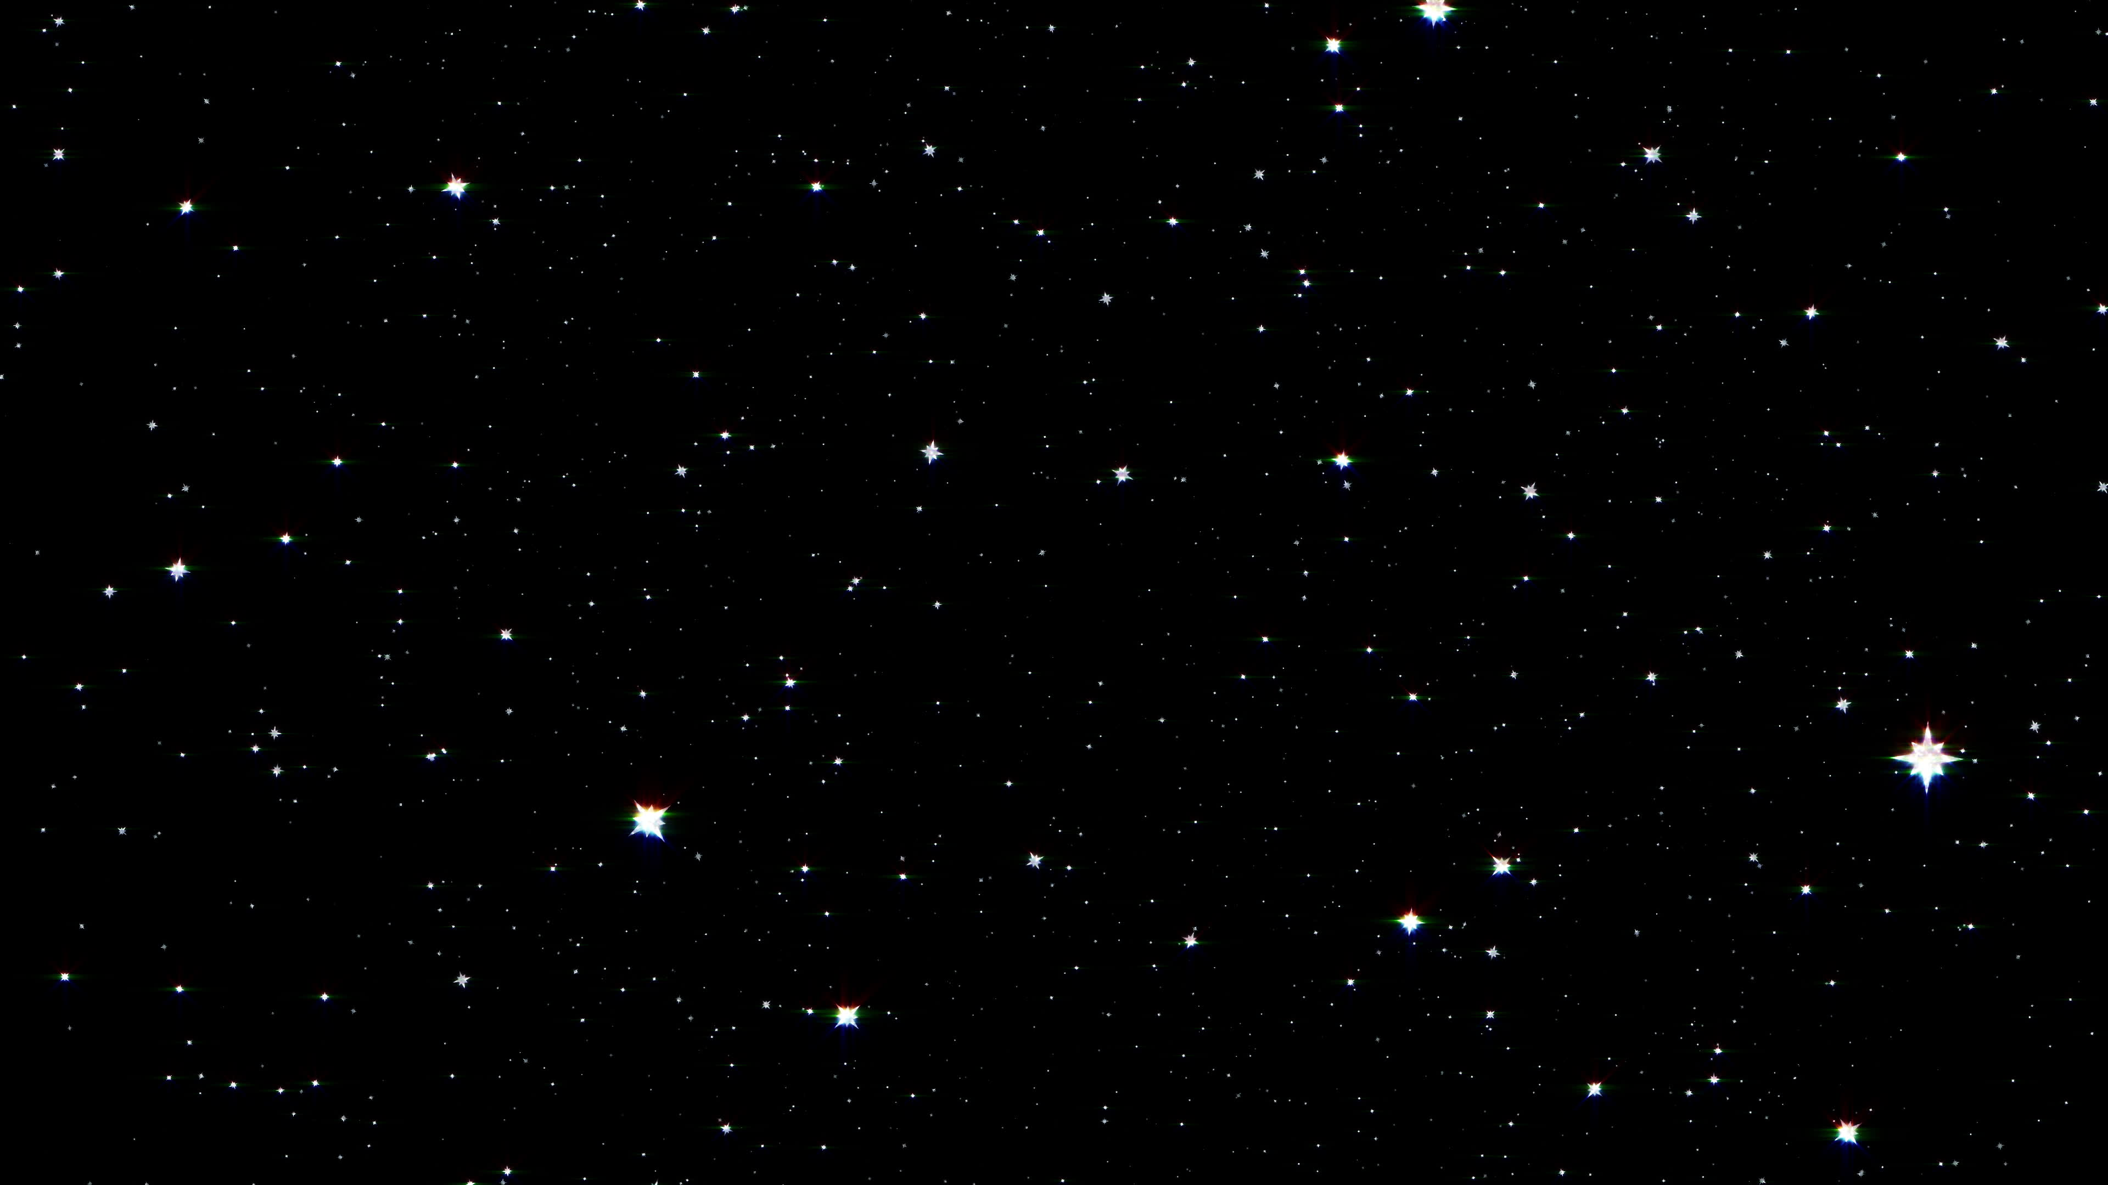
STARRY SKY

Slide 49
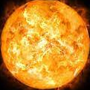
The Sun is a star

Slide 50
Planets

Slide 51
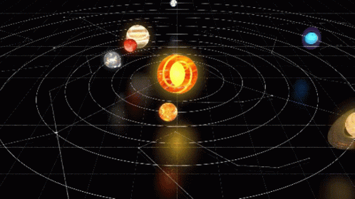
All planets revolve around the sun

Slide 52
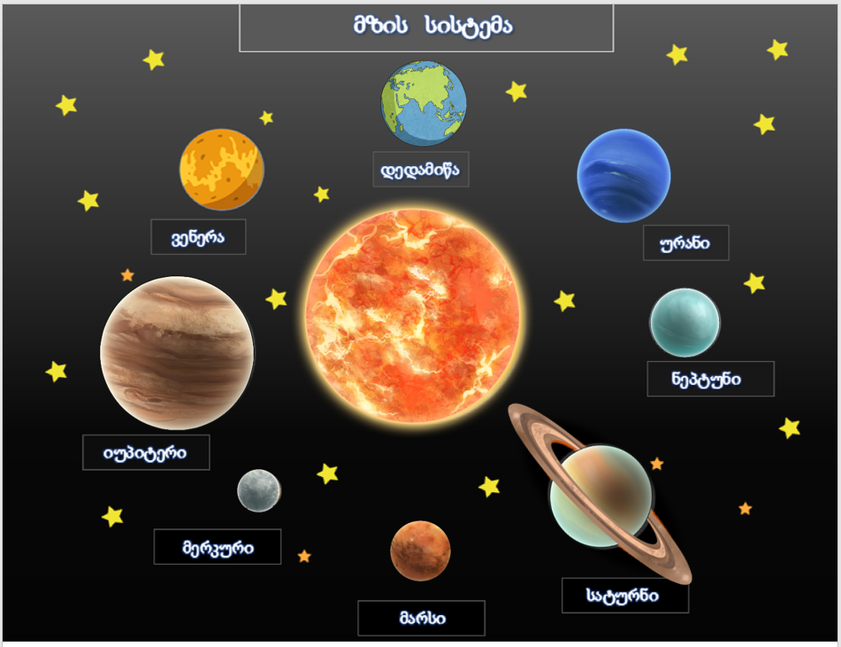
Solar System
Earth
Venus
Uranus
Neptun
Jupiter
Mercury
Saturn
Mars

Slide 53
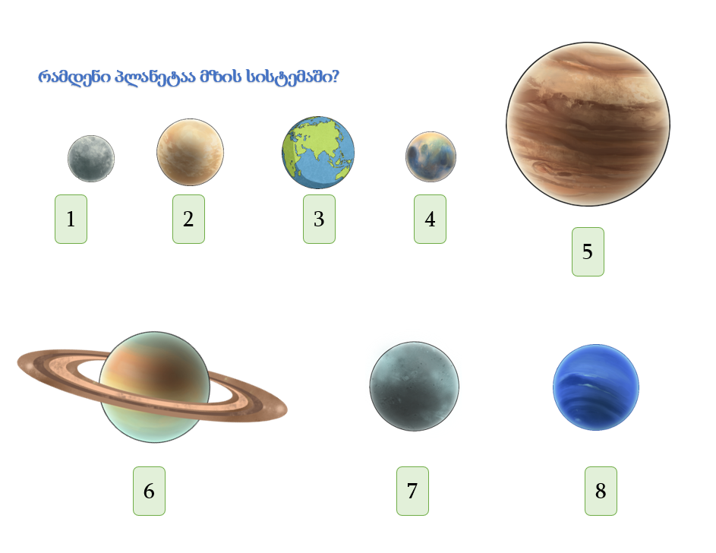
How many planets are there in the solar system?

Slide 54










Build a Solar System

Slide 56
Correct Version

Slide 57
Jupiter is the largest planet

Slide 58

Make up a word
J
P
U
I
R
T
E

Slide 59
Mercury is the smallest planet

Slide 60

Make up a word
M
U
E
C
Y
R
R

Slide 61
Build your own planet

Slide 62
Our planet - Earth

Slide 63


Earth

Slide 64


What shape does the Earth have?

Slide 65
Make up a word
A
E
R
H
T

Slide 66
Land
Ocean

Slide 67

Land
https://www.youtube.com/watch?v=Faow3SKIzq0
Follow the link below

Slide 68

Ocean
https://www.youtube.com/watch?v=czry9aZBvQY
Follow the link below

Slide 69

Earth revolves around the Sun

Slide 70
Alphabet

Slide 71
A
A

Slide 72
A
C
B
A

Slide 73
A
C
B
A

Slide 74
B
B

Slide 75
B
A
C
B

Slide 76
A
C
B
A

Slide 77
C
C

Slide 78
C
A
B
C

Slide 79
C
C
B
A

Slide 80
D
D

Slide 81
D
A
B
D

Slide 82
D
C
D
A

Slide 83
E
E

Slide 84
E
A
C
E

Slide 85
E
E
D
A

Slide 86
F
F

Slide 87
F
A
E
F

Slide 88
F
E
F
A

Slide 89
F
F

Slide 90
F
A
E
F

Slide 91
F
E
F
A

Slide 92
G
G

Slide 93
G
A
E
G

Slide 94
G
E
F
G

Slide 95
H
H

Slide 96
H
A
G
H

Slide 97
H
H
F
A

Slide 98
I
I

Slide 99
I
A
G
I

Slide 100
I
I
F
A

Slide 101
J
J

Slide 102
J
D
E
J

Slide 103
J
E
J
A

Slide 104
K
K

Slide 105
K
I
E
K

Slide 106
K
E
I
K

Slide 107
L
L

Slide 108
L
K
E
L

Slide 109
L
L
F
K

Slide 110
M
M

Slide 111
M
H
K
M

Slide 112
M
M
F
A

Slide 113
N
N

Slide 114
N
K
E
N

Slide 115
N
E
N
K

Slide 116
O
O

Slide 117
O
A
J
O

Slide 118
O
J
F
O

Slide 119
P
P

Slide 120
P
A
K
P

Slide 121
P
P
F
A

Slide 122
Q
Q

Slide 123
Q
A
K
Q

Slide 124
R
R
F
K

Slide 125
S
S

Slide 126
S
A
E
S

Slide 127
S
S
J
A

Slide 128
T
T

Slide 129
T
G
E
T

Slide 130
T
T
F
A

Slide 131
U
U

Slide 132
U
A
E
U

Slide 133
U
E
U
B

Slide 134
V
V

Slide 135
V
G
B
V

Slide 136
V
E
V
G

Slide 137
W
W

Slide 138
W
E
B
W

Slide 139
W
W
F
B

Slide 140
X
X

Slide 141
X
G
K
X

Slide 142
X
X
F
A

Slide 143
Y
Y

Slide 144
Y
W
X
Y

Slide 145
Y
X
W
Y

Slide 146
Z
Z

Slide 147
Z
Y
X
Z

Slide 148
Z
X
Y
Z

